Slide 1
TDD Revisited
Where it all went wrong - guidance on what to do instead

Slide 2
Who are you?
Software Developer for more than 20 years
Worked mainly for ISVs
Reuters, SunGard, Misys, Huddle
Worked for a couple of MIS departments
DTI, Beazley
Microsoft MVP for C#
Interested in architecture and design
Interested in Agile methodologies and practices
No smart guys
Just the guys in this room

Slide 3
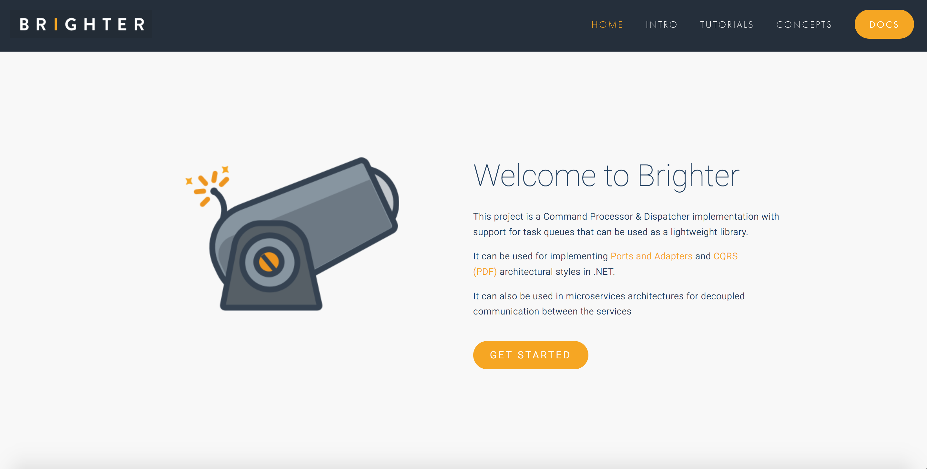

Slide 4
Agenda
The Fallacies of TDD
Clean Architecture
Summary

Slide 5
The Fallacies of TDD

Slide 6
Fallacy
1: Developers write Unit Tests
Notes:
When engineers talk about TDD, they often associate it with the idea of a developer writing a unit test.
This fallacy has led to many of the problems with how TDD is practiced.

Slide 7
Definition
To unit test requires test doubles, it’s how you isolate. The SUT must be able to replace any dependency with a test double (a mock)
To isolate issues that may arise, each test case should be tested independently. Substitutes such as method stubs, mock objects, fakes, and test harnesses can be used to assist testing a module in isolation.
In unit testing isolation becomes how approach testing. We isolate one SUT from another for defect localization.
Originates with modules being separately tested.
https://en.wikipedia.org/wiki/Unit_testing
Notes:
If we assume that TDD uses unit tests, that comes with some constraints that come from classical testing theory.
Unit tests isolate the module. To do that all dependencies of the module are replaced, for the test with a ‘test double’ a stub, fake or mock. The replacement should be predictable, so that we can isolate any failure to the unit under test, not its collaborators
Integration tests connect two modules together to determine if they can hook together.
System tests integrate all the modules and let us run end-to-end.
Typically, in OO TDD, the module is identified as a class. This means that we end up mocking all of the dependencies of our class

Slide 8
Belief
To do this, we either have to design our class hierarchy before writing a test, and know we will mock a call…
Need-driven Development [is a] variation on the test-driven development process where code is written from the outside in and all depended-on code is replaced by Mock Objects that verify the expected indirect outputs of the code being written.
The consequence here is that we must understand the details of the SUT not just the contract… the details are coupled to our test, we can’t change them without changing our tests.
… or we need to stop when we hit something outside our single responsibility when implementing and replace it with a test double.
Meszaros, Gerard. xUnit Test Patterns
Notes:
The assertion that we are doing “unit testing’ lead to the privileging of the idea that you should mock all the dependencies of the SUT, in order to isolate it. The cry was ‘defect localization’. We want to know what ‘failed’ and that means only one one test should fail for any given line of code, and if we include dependencies, how we will know it was our code and not a collaborator. So all or our collaborators will behave perfectly.
This idea, which Meszaros calls Need-Driven Development has all ‘dependencies’ replaced with a mock, often so that we define the interface of the collaborator when implementing the SUT.

Slide 9
Experience
The DI requirements here lead us towards an IoC container over Poor Man’s DI because we have a graph of dependencies to realize at rnntime
In a strongly-typed language this means an interface stands-in for the actual dependency and must be injected into our SUT.
When I look around now, I see a lot of people using mocks to replace all their dependencies. My concern is that they will begin to hit the Fragile Test issues that mocks present. Gerard Meszaros identifies the issues we hit as two specific smells: Overspecified Software and Behavior Sensitivity.
Our tests should focus on the contract, but here they focus on the implementation, which makes them hard to read as there is a lot of setup code.
If we change how our code works, a lot of tests may break – we say that our tests are sensitive to changes in the details.
http://codebetter.com/iancooper/2007/12/19/mocks-and-the-dangers-of-overspecified-software/
Notes:
Mocks and the Dangers of Overspecified Software
Posted by Ian Cooper on December 19, 2007
I’ll be back on LINQ architecture after the holidays, but in the meantime, I wanted to share some of the bad, some of the places where we have had bitter experiences.
When NMock first appeared we embraced the behaviour verification style that it supported. We liked the idea that for ‘unit tests’ we should not interact with other concrete classes. We liked the way that mocks had to derive from interfaces, abstract classes, or override virtual methods. We wanted to depend upon abstractions, not details, and we liked the way that mocks gave us an emergent design that exhibited this quality.
One of our first pushes was against slow tests that talked to the Db. Writing our tests against any kind of shared fixture was painful (note that in NUnit, MbUNit, MSTest et al. class variables are shared state for all tests in the fixture; xUnit tries to fix this but writing tests against shared state in the Db was especially painful. Either tests influenced each other, or we wrote complex setup and tear down code. Even using tricks like OleTx transactions we still had to pre-populate the Db or setup everything each time. And the tests were slow…
So we mocked out our DataMappers and, freed from the dependency on the Db, testing our Domain proceeded like a dream.
The project inherited a byzantine legacy Db schema that was not amenable to an mapping via an ORM tool (at least at the state-of-the-art for that time), so we had to roll our own DataMappers. Due to the limited re-use options outside this context, instead of rolling our own reflection and generics approach, with its attendant complexity, we opted to aim for a solution that we could eventually just code-gen. Keen to build via TDD, then code-generate once we were sure it worked, we wanted to drive development of our DataMappers via TDD. Inferring from our wins with mocks in the domain, we expected to be able to gain similar benefits by mocking out our DataMappers interaction with the Db (mea culpa).
So, to persist, we created an abstraction of the Db, an IDatabase. Then mocked that IDatabase in our unit test and created expectations of the behaviour that of our mappers, by expecting calls to the Db to execute sql. This enabled us to check that we created the stored procedure calls we would expect. To create parameter lists for those procedures we created classes (which we intended to eventually generate) that mapped domain objects into SQL parameters.
To materialize objects back out we created classes (which we would again auto-generate) that gave us the ordinals needed to read the fields from the row corresponding to the class. We used a dependant mapping strategy, so that our domain worked with a DataMapper for a root class but we loaded any child entities and value objects.
Of course, we still needed integration tests to see if they would actually work, and of course, we found that some of the SQL code we were generating passed unit tests, but failed when run against the Db, but overall we were pretty proud of how we were testing the Db. There were some warnings (and one member of the team expressed doubts) but it seemed to go pretty well. As an aside, as we were only mapping out a few classes, the pressure to code generate never hit us. Believing that we needed to build 2 or 3 mappers before we would see our mapper design emerge (by refactoring to remove duplication) we never reached the point where we needed to push on from there to code generation to complete our persistence requirements. Simply put, we did not need to persist enough items that the cost of writing code generation became less than the cost of implementing the remaining mappers by hand.
The problems began to hit us in maintenance (and that can hit quite early on an agile project with frequent releases). We had a number of issues: Mocking tools were not strongly-typed At that time the mocking tools just used strings, there was none of the record-and-replay style seen within tools like Rhino Mocks. This is not only important because the compiler can no longer help you find errors, but because refactoring tools stop helping you make changes when a string is the method call. So Rename Method to express intent, became search-and-replace. Unit tests would pass, but integration tests failed, because the names had changed.
The test code was over-coupled A lot of our test code contained a dozen lines of set up for mocking along the lines of:
database.Expect(“AddInParameter”, dbCommand.MockInstance, “@Username”, DbType.String, person.UserName); database.Expect(“AddInParameter”, dbCommand.MockInstance, “@FirstName”, DbType.String, person.FirstName); database.Expect(“AddInParameter”, dbCommand.MockInstance, “@MiddleInitial”, DbType.String, person.MiddleInitial); database.Expect(“AddInParameter”, dbCommand.MockInstance, “@Surname”, DbType.String, person.Surname);
The tests are coupled not only to the domain model but the schema, and represented a point of resistance to change for us.
Tests predicted the implementation rather than letting it evolve through refactoring The tests specified the implementation and as such writing the test constrained the implementation. This broke the more normal TDD pattern of make it pass then refactor. Writing the specification for the implementation in the tests is expensive, and error prone.
Changes to implementation were Shotgun Surgery When you change the implementation of a method under test, mocks can break because you now make additional or different calls to the dependent component that is being mocked. For us, if you needed to add an extra parameter to a domain class under our model for example, you had to create the expectation for that parameter in the test. After a while the process of adding a new field became expensive, and the number of changes required to add a new method began to smell of shotgun surgery. The trouble had become that our tests not only specified the inputs and outputs but also how the method under test was implemented: the order and number of calls.
The mocks began to make our software more resistant to change, more sluggish, and this increased the cost to refactoring. As change becomes more expensive, we risked becoming resistant to making it, and we risk starting to build technical debt. A couple of times the tests broke, as developers changed the domain, or changed how we were doing persistence, without changing the test first, because they were frustrated at how it slowed their development. The mocks became an impedance to progress.
Mocks had become, for us, fragile tests.
Red, Green, Refactor Agile methodologies allow a just-in-time design approach because you can refactor existing code at low-cost and risk. Unit tests enable this scenario, because they protect against changes in behaviour of the system under test. You can change the implementation, provided the behaviour remains the same. However when mocks are fragile, and risk becoming an obstacle to change, because they can break even when the behaviour remains consistent they can increase the cost of refactoring.
Maybe we should have just done integration testing? By contrast the effort to check the classes using integration tests turned out to be quite small in this instance, because we only needed to check our ability insert, update, and delete on each mapper. We had gained a lot by removing our dependency on the Db from the domain with the DataMapper, but our desire to mock out the Db on the implementation of the DataMapper, looked as though it cost us more than it saved. It was a bridge too far.
Fragility and Mocks When I look around now, I see a lot of people using mocks to replace all their dependencies. My concern is that they will begin to hit the Fragile Test issues that mocks present. Gerard Meszaros identifies the issues we hit as two specific smells: Overspecified Software and Behaviour Sensitivity.
Test Doubles Gerard Meszaros classifies any object we use to stand in for another object during a test as a Test Double. It is worth reading what Gerard has to say either on the web site or in his book. The key is to understand that you are replacing a dependency to isolate the object under test from either Indirect Inputs or Indirect Outputs. Mocks are really only a sweet spot for testing indirect outputs. If you have indirect inputs, a Test Stub or Fake Object may be a more maintainable approach than a mock. Even for indirect ouputs it is worth considering a Test Spy (we find the Self-Shunt variation particulary simple to use) or Test-Specific Subclass before looking at a mock.
Switching to fakes and stubs Since that project we have weaned ourselves from our mock dependency and try to use what Fowler calls a classicist approach to TDD more. Where we do replace a depended upon component, we try to use the appropriate technique, depending on whether our concern is an indirect input or an indirect output in the dependency. In addition when talking to the outside world we weigh up the point at which the ‘last mile’ should be checked with an intergration test over a unit test. So while I want to isolate my domain, I may make different jhdgements in the service layer. Mocking frameworks are powerful, but ‘with great power comes great responsibility’.

Slide 10
Principle
1: Developers write Developer Tests
Notes:
When engineers talk about TDD, they often associate it with the idea of a developer writing a unit test.
This fallacy has led to many of the problems with how TDD is practiced.

Slide 11
Observation
This is the only use of the phrase “unit test” in the book, Kent is referring here to his use of the term “unit test” in casual conversation or by implication from xUnit tools.
I call them “unit tests,” but they don't
match the accepted definition of unit tests very well
Tests as defined in this book don’t have any of the characteristics of “unit tests” as described in our earlier definition around isolation.
Kent Beck, TDD By Example
Notes:
In fact, Kent only uses the term unit test in this quote, and in a discussion of the problems of acceptance testing. Small-scale test is the alternative to unit test he suggests in the same paragraph. Nearly everywhere else Kent in his book Kent just says ‘test.’
Co-opting the word ‘unit test’ into our lexicon to describe what a developer writes in the TDD process has a number of problems, derived from the association with the principles of classical unit testing.

Slide 12
Observation
By this we mean the contract that your code exposes to other callers. Your test is an expression of that observable behavior.
TDD is contract-first.
Refactoring is one of the three steps in TDD. If you don’t refactor much, it’s a smell you are thinking too much upfront.
Refactoring (noun): a change made to the internal structure of software to make it easier to understand and cheaper to modify without changing its observable behavior.
The key idea here: you can change your code’s details without changing the tests. That is refactoring. It’s safe because the behavior to preserve is expressed by the test!
https://martinfowler.com/bliki/DefinitionOfRefactoring.html
Notes:
But when we think about TDD, we must think about it’s cycle: Red-Green-Refactor. If Kent is the father of TDD, Martin Fowler became its godfather with his deeper explanation of refactorings - changing structure without changing the behaviour. Refactoring focuses on the implementation details, not on the behaviour of its external interface.
Changing the structure of your implementation, should not break any tests, only changing the behaviour of the SUT should. Indeed the ability to keep your tests green between steps of the refactoring is what makes refactoring ‘safe’ as opposed to re-engineering which is unsafe as it requires regression. YOUR TESTS SHOULD NOT BREAK DURING REFACTORING.

Slide 13
Observation
In other words, when we change the implementation without changing the contract of what is under test, then the tests don’t change.
If the program’s behavior is stable from an observer’s perspective, no tests should change.
TDD is a Contract-First approach to testing. Behavior in this context means that contract.
https://medium.com/@kentbeck_7670/programmer-test-principles-d01c064d7934
Notes:
And this implies that the tests should not need to change, if the behaviour does not change. A refactoring should not change a TDD test. Indeed the TDD test confirms that the behavior remains the same after the refactoring. It is the very heart of how our refactoring is enhanced by tests, and how we are able to refactor after we reach –green, because we have passing tests, as long as the tests keep passing our refactoring breaks nothing.

Slide 14
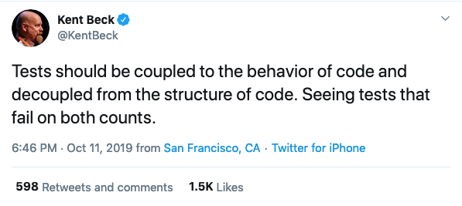
Observation
Our tests are coupled to the contract expressed by the code
Our tests should not couple to the implementation details i.e. via mocks that check details.
https://twitter.com/KentBeck/status/1182714083230904320
Notes:
Kent acknowledge that TDD By Example did not explicitly call out this problem of tests that are sensitive to the structure of the code – his equivalen to Meszaros’s fragile test and confusingly behavior-sensitivity. Kent means externally visible behavior, Meszaros means unobservable behavior or Kent;s structure.
Fragile Tests became the bane of much of testing. Change the contract of a Depended upon Component and spend the next few hours fixing up broken tests. This might be vaguely justifiable for a component we did not control, where the interaction with the third party component was what was under test – although I don’t think that is the way to go – it becomes nonsense when we control both the SUT and DOC

Slide 15
Observation
Tests should not use mocks to isolate the SUT, so they are not unit tests!!!!
My personal style is I just don’t go very far down the mock path… your test is completely coupled to the implementation not the interface… of course you can’t change anything without breaking the tests
The consequence of using mocks to observe the indirect outputs will be coupling of tests to details…
Kent Beck https://www.youtube.com/watch?v=z9quxZsLcfo
Notes:
Kent addressed this issue in his discussion of TDD with Martin Fowler and DHH in 2014. He discussed the specific problem that developers would often report fragile tests, and when he looked at them, he could see mocks returning mocks, returning mocks. The software was highly coupled to the tests – no wonder it would break tests on any chane

Slide 16
Definitions
The fundamental principle of unit testing.
Failure of a Unit Test shall implicate one and only one unit. (A method, class, module, or package.)
Failure of a Programmer Test, under Test Driven Development, implicates only the most recent edit.
The fundamental principle of TDD
https://wiki.c2.com/?ProgrammerTest
https://wiki.c2.com/?DeveloperTest
Notes:
The XP Community renamed Unit Tests to Developer Tests, for use with TDD, as far back as 2010, and to Programmer Tests in 2013
Under Mezarios’s patterns n Xunit Patters, Programmer Tests are actually closer to Component Tests than Unit Tests: http://xunitpatterns.com/component%20test.html

Slide 17
Statement
Use this name, or Programmer Tests, to avoid confusion with unit testing principles.
Note that TDD is a process of discovery
Test Driven Development produces Developer Tests. The failure of a test case implicates only the developer's most recent edit. This implies that developers don't need to use Mock Objects to split all their code up into testable units. And it implies a developer may always avoid debugging by reverting that last edit.
Don’t use mocks to isolate the SUT when doing Developer Tests. It is a different practice. Know which practice you are using and its trade-offs.
https://wiki.c2.com/?UnitTest
Notes:
This is really just a summary: TDD tests are small-scale, programmer tests, where failure just indicates that the last edit is suspect. We can revert the change to remove the error. Defect localization is by change/edit.

Slide 18
Observation
I/O is the most common shared fixture
Tests are isolated from each other. So that we can run them in parallel. This keeps them fast.
How should the running of tests affect one another? Not at all.
The most common reason for interference is shared state, called shared fixture and we mock shared fixture to allow tests to work in parallel.
We also tend to mock I/O for:
Speed – tests should be fast!
Fragility – it can make tests fail unexpectedly
Kent Beck, TDD By Example
Notes:
It is the test fixture that is the unit of isolation, not the ‘system under test’. We don’t want to tests to break each other.
This is the major constrained on so called shared fixture elements: file systems, databases etc. One test can impact another test running against a shared resource. This may create the conditions to replace with a mock or test-double so as to free up from a shared fixture
Tests need to be fast, and run independently and in-parallel

Slide 19
Fallacy
2: The trigger for a new test is a new function
Notes:
By function here, we mean instance method, class method, stand alone function etc. The scope is irrelevant.
Our concern is what triggers writing a test? It is often expressed that before you write a new function at any scope, you should write a test.
A lot of tutorials encourage you to write a new test for any new method that you write.

Slide 20
Definition
A function has pre-conditions and post-conditions, a test simply asserts that for a given set of pre-conditions, we get the relevant post-conditions
Write a test that defines a function or improvements of a function
Implementation is simply the algorithm to turn the pre-conditions into the post-conditions
https://en.wikipedia.org/wiki/Test-driven_development
Notes:
A common approach is to write a test because you want to write a new function, or method on a class. Any function has inputs and either direct of indirect outputs. There are pre-conditions – state of the system before – and post-conditions –state of the system after. A test simply confirms these. If the method has not return value, it is necessary to use mocks to spy on indirect outputs.

Slide 21
Belief
Testing is about confirming the behavior of our functions. We may want to use techniques like parameterized testing to allow us to easily vary input, test edge conditions etc.
Requires acceptance tests to confirm that these functions whilst correct, produce behavior that is correct overall.
The function is the System-Under-Test (SUT)
The desire to test methods on classes in languages that provide access control leads to the question of how to test private methods.
Test Coverage of 100% can be achieved if we test every method, and all the possible paths through that method.
Notes:
In this approach the function is the SUT. We require

Slide 22
Experience
If we returned because it has gone red – it is breaking – why has is broken? Is it because the acceptance criteria or our implementation changed?
When we return to our tests – it is often difficult to understand their intent
A promise of TDD was executable specifications. We would not documentation, because our tests would document how to use our code through clear examples. Yet in many cases our tests are just confusing.
Notes:
- Is it broken because the behavior has changed? Where is that behavior expressed?

Slide 23
Principle
2: The trigger for a new test is a new behavior
Notes:
By function here, we mean instance method, class method, stand alone function etc. The scope is irrelevant.
Our concern is what triggers writing a test? It is often expressed that before you write a new function at any scope, you should write a test.
A lot of tutorials encourage you to write a new test for any new method that you write.

Slide 24
Observation
When we add amounts in two different currencies
Then we convert the result
We need to be able to add amounts in two different currencies and convert the result given a set of exchange rates.
Given a set of exchange rates
Kent Beck, TDD By Example
Notes:
This is an example that Kent gives in TDD by example. It is literally an example of the requirement that drives testing.
We could rephrase it using a GWT syntax
Given I have two amounts of different currencies and an exchange rate table when I add the two currencies together I should be able to get a result in one of the currencies

Slide 25
Observation
When we structure our test we can represent GWT as the Four-Fold Test (Setup [Given], Exercise [When], Verify[Then], Teardown - Meszaros
Given the state of the world before the test
We can also use Act, Arrange, Assert – Bill Wake
Given a set of exchange rates,
When I add two amounts in different currencies together,
Then I get a result in the first currency.
When I exercise the behavior under test
Then we expect the following changes
GWT from BDD by Daniel Terhorst-North
Notes:
This is an example that Kent gives in TDD by example. It is literally an example of the requirement that drives testing.
We could rephrase it using a GWT syntax
Given I have two amounts of different currencies and an exchange rate table when I add the two currencies together I should be able to get a result in one of the currencies

Slide 26
Observation
This switch is really about moving away from understanding TDD as a technique for testing, to a contract first technique for exploring how an API solves requirements
I found the shift from thinking in tests to thinking in behaviour so profound that I started to refer to TDD as BDD, or behaviour- driven development.
At first BDD is just a name for TDD that doesn’t carry the confusion around testing.
Later BDD becomes a practice, with specification by example tooling, lifecycle. This is not about that BDD.
https://dannorth.net/introducing-bdd/
Notes:
Dan North’s famous name change originally related to this observation, that what Kent was doing was driving development through iterations of the behavior of the system, not through iterations of the implementation of the system.
For this reason he rephrased TDD as BDD

Slide 27
Statement
What is the smallest change you could make to the SUT that expresses a change to the acceptance criteria for a behavior? Test that.
This is: the question that answers everything: what test do I write next?
The next test you write in TDD is just the most obvious step that you can make towards implementing the requirement given by a use case or user story.
Wait, if TDD captures requirements, what are Acceptance tests for? More on this later.
A use case or user story tells us what a customer needs us to build – the behavior that the system should exhibit. The acceptance criteria for that drive our tests.
Notes:
Out test are focused on moving towards completion of the use case or user story. We drive incrementally and iteratively toward the expression of that behaviour in our tests.
Does that require a single method on a class, or a single function? Perhaps. But it might require many collaborating objects. We use tests to find out.
They are programmer tests, so the SUT required does not have to be an isolated class, method of function. We can test at whatever level is appropriate.
The requirement is what matters and we go up and down in viewpoint as required, to get the requirement under test.

Slide 28
Observation
By implication this must not be exported – public – but be hidden – private – as it can’t be part of the contract. So it is already covered by the existing tests.
Remember that green phase is a transaction script – discovering the algorithm – so we have poor structure, that emerges in refactoring
You do not write new tests if you introduce new methods when refactoring to clean code.
This could be a new class too As long as it is a detail of refactoring.
Refactoring is changing the implementation without changing the behavior – we do not change the contract when refactoring

Slide 29
Fallacy
3: Customers write Acceptance Tests
Notes:
When engineers talk about TDD, they often associate it with the idea of a developer writing a unit test.
This fallacy has led to many of the problems with how TDD is practiced.

Slide 30
This requires us to author a tool that supports Data-Driven Tests like Fit or DSL scripting like Cucumber;
We test the story not a unit – but isn’t that TDD?
Definition
Originally called Functional Tests because each acceptance test tries to test the functionality of a user story.
Acceptance tests are different [is] modeled and possibly even written by the customer. ...Hence the even-newer name, Customer Test.
If the Customer defines the acceptance criteria, can they write a test that expresses this? A script that exercises the software?
On-site customer was an important XP concept – a domain expert the team could question, often replaced with a Product Owner today
https://wiki.c2.com/?AcceptanceTest
Notes:
Early on XP privileged the idea of the on-site customer. XP recognized that the benefit of agile came from ‘shortening the feedback loop’ and it promoted the idea of the on-site customer for that. A user-story was just a place holder to have a conversation with a customer about a requirement. When pulled from the backlog, the team designed the solution to meet acceptance criteria defined by the customer. Those criteria were codified by the Given-When-Then pattern.
Supposedly tools like Cucumber. Fit/Fitnesse, RSpec empowered Customers to write the tests instead of Developers. This involvement of the Customer with the specification of the test was seen as the holy grail – quality at the front of the line – rather than catch bugs when the customer reviewed at the beginning of the line, we would catch them at the end

Slide 31
Experience
Remember these are Customer Tests, that is why we use FIT or Cucumber et al. to facilitate their interaction i.e. writing the tests.
These two problems--that customers don't participate, which eliminates the purpose of acceptance testing, and that they create a significant maintenance burden, means that acceptance testing isn't worth the cost. I no longer use it or recommend it.
This is key: acceptance tests written using FIT or Cucumber are more expensive to write, because you need to translate to inputs, and more expensive to own as they expensive to change
James Shore, http://www.jamesshore.com/Blog/The-Problems-With-Acceptance-Testing.html
Helped write FIT. So he is not just a critic, he built the tooling we are talking about.
Notes:
James Shore was one of the authors of FIT. FIT was a tool for writing Customer Tests in a way that Customers could at least read, if not write themselves. FIT was table driven, using HTML tables to encode tests. These tables could then be parsed and used to provide parameters to test methods.
The idea was that customers could play with the tool, typing in numbers, seeing the effects.
The limitations of table-driven testslet some to create DSL customer tools that looked like natural language, such as Cucumber. The idea was that these drove not only the parameters to the tests, but the ubiquitous language used by customer and developers.
In reality this approach was problematic:
Customers were hard-pressed to write acceptance criteria in a Table or GWT style – it generally required a requirements gathering session
Customers rarely if ever reviewed the tests to examine an executable specification for the software
Tests are mostly red, because new tests do not go green until the end of the iteration. This means that tests break and no one fixes them until all the stories pass at the end of the iteration – which moves us into testing outside the iteration boundary with no real notion of Done-Done
Tests require an extra level of indirection for developers who have to turn the DSL into executing code.
They are fragile when changed
They rarely run in under 2 mins, so they fail the fast property and are only executed at integration, again more time spent red.
FIT was really intended for domain exploration, but ended up an end-to-end integration testing tool
I have used them and pushed teams to use them, despite resistance. They spend most of their time red unless we downed tools to ‘fix’ them and provided little value as customers never reviewed them.

Slide 32
Experience
ATDD only exists because we don’t believe that TDD does this.
ATDD is perilous because it implies that TDD does not deal with the acceptance criteria for user stories
Remember we established earlier that TDD is driven by acceptance criteria from a user story. So there is no difference in intent.
Notes:
Perhaps most of all, ATDD has rotted our TDD practice, because it implies that the focus of TDD is not on the acceptance criteria for a story, but on the granular implementation of details of an ATDD test. This has reduced TDD from the driver of acceptance criteria to a secondary practice when it encompassed the exploration of that criteria originally.
ATDD exists because people who misunderstood TDD realized that we need acceptance criteria for stories and because they were no longer using TDD to drive that, they were forced to invent ATDD to do it, justifying it on the basis of a customer involvement in using ATDD tools that was rarely if ever realized.

Slide 33
Experience
Another aspect of ATDD is the length of the cycle between test and feedback. If a customer wrote a test and ten days later it finally worked, you would be staring at a red bar most of the time.
Kent Beck, TDD By Example
If the tests are nearly always red, developers don’t run the ATDD suite until the end. And if they are integrating with others, they miss integration issues and have to scramble to get the tests passing.
Notes:
Perhaps most of all, ATDD has rotted our TDD practice, because it implies that the focus of TDD is not on the acceptance criteria for a story, but on the granular implementation of details of an ATDD test. This has reduced TDD from the driver of acceptance criteria to a secondary practice when it encompassed the exploration of that criteria originally.
ATDD exists because people who misunderstood TDD realized that we need acceptance criteria for stories and because they were no longer using TDD to drive that, they were forced to invent ATDD to do it, justifying it on the basis of a customer involvement in using ATDD tools that was rarely if ever realized.

Slide 34
Principle
3: Customers specify Acceptance Criteria
Notes:
When engineers talk about TDD, they often associate it with the idea of a developer writing a unit test.
This fallacy has led to many of the problems with how TDD is practiced.

Slide 35
Statement
Example-driven development is another name for this style – but its really TDD done right. This produces the GWT we use for our test
Customers illustrate their descriptions with concrete examples…programmers use these examples to guide their work…Sometimes [programmers] use the examples directly in their tests…More often…programmers use the examples as a guide, writing a multitude of more focused, programmer-centric tests as they use TDD
This also achieves self-documenting code
https://www.jamesshore.com/v2/blog/2010/alternatives-to-acceptance-testing
Notes:
We still like the idea that the customer participates in specification, when we expand on the requirements in the user story. The user story is still a ‘promise for conversation’ and in the elaboration step we do design. We discuss the acceptance criteria, the requirements defined as tests: what are we building, and how we will build it, the architecture of our implementation.
This discussion should be recorded, but it can be done in markdown or text, and little more structure than Given-When-Then. It does not have to be automated, it can be turned into automated tests by developers, in the same way any design decision are translated into code at the last responsible moment
Acceptance criteria inform unit tests over driving automated acceptance tests.

Slide 36
Fallacy
4: It doesn’t matter if you are test first or test last
Notes:
When engineers talk about TDD, they often associate it with the idea of a developer writing a unit test.
This fallacy has led to many of the problems with how TDD is practiced.

Slide 37
Test last does tests after software is written. It is conventional unit, integration and acceptance testing, but practiced by developers with xUnit tools.
Definition
﻿A development process that entails executing unit tests after the development of the corresponding units is finished.
Implicitly modeling occurs before development. This may be a lightweight process like CRC cards, or heavier exploration via UML
The feedback loop is long. The design takes to implement. In a RAD environment this may be a few days, it might be following iteration though or beyond.
Notes:
Early on XP privileged the idea of the on-site customer. XP recognized that the benefit of agile came from ‘shortening the feedback loop’ and it promoted the idea of the on-site customer for that. A user-story was just a place holder to have a conversation with a customer about a requirement. When pulled from the backlog, the team designed the solution to meet acceptance criteria defined by the customer. Those criteria were codified by the Given-When-Then pattern.
Supposedly tools like Cucumber. Fit/Fitnesse, RSpec empowered Customers to write the tests instead of Developers. This involvement of the Customer with the specification of the test was seen as the holy grail – quality at the front of the line – rather than catch bugs when the customer reviewed at the beginning of the line, we would catch them at the end

Slide 38
Experience
How do we know when we are Done?
If you write code that is not needed by the given requirements you are engaging in speculation. Most likely you will be wrong. The code will not be needed or you will have to re-work that code.
Whilst we may think it will be needed, often the cost-value turns out to be poor and the customer doesn’t want it. But we already paid for it.
Even if we guess right, most likely we have to re-work because the requirements are not right. In the worse case we refuse to abandon our speculation and force it to work with hacks.
Notes:
Mocks and the Dangers of Overspecified Software
Posted by Ian Cooper on December 19, 2007
I’ll be back on LINQ architecture after the holidays, but in the meantime, I wanted to share some of the bad, some of the places where we have had bitter experiences.
When NMock first appeared we embraced the behaviour verification style that it supported. We liked the idea that for ‘unit tests’ we should not interact with other concrete classes. We liked the way that mocks had to derive from interfaces, abstract classes, or override virtual methods. We wanted to depend upon abstractions, not details, and we liked the way that mocks gave us an emergent design that exhibited this quality.
One of our first pushes was against slow tests that talked to the Db. Writing our tests against any kind of shared fixture was painful (note that in NUnit, MbUNit, MSTest et al. class variables are shared state for all tests in the fixture; xUnit tries to fix this but writing tests against shared state in the Db was especially painful. Either tests influenced each other, or we wrote complex setup and tear down code. Even using tricks like OleTx transactions we still had to pre-populate the Db or setup everything each time. And the tests were slow…
So we mocked out our DataMappers and, freed from the dependency on the Db, testing our Domain proceeded like a dream.
The project inherited a byzantine legacy Db schema that was not amenable to an mapping via an ORM tool (at least at the state-of-the-art for that time), so we had to roll our own DataMappers. Due to the limited re-use options outside this context, instead of rolling our own reflection and generics approach, with its attendant complexity, we opted to aim for a solution that we could eventually just code-gen. Keen to build via TDD, then code-generate once we were sure it worked, we wanted to drive development of our DataMappers via TDD. Inferring from our wins with mocks in the domain, we expected to be able to gain similar benefits by mocking out our DataMappers interaction with the Db (mea culpa).
So, to persist, we created an abstraction of the Db, an IDatabase. Then mocked that IDatabase in our unit test and created expectations of the behaviour that of our mappers, by expecting calls to the Db to execute sql. This enabled us to check that we created the stored procedure calls we would expect. To create parameter lists for those procedures we created classes (which we intended to eventually generate) that mapped domain objects into SQL parameters.
To materialize objects back out we created classes (which we would again auto-generate) that gave us the ordinals needed to read the fields from the row corresponding to the class. We used a dependant mapping strategy, so that our domain worked with a DataMapper for a root class but we loaded any child entities and value objects.
Of course, we still needed integration tests to see if they would actually work, and of course, we found that some of the SQL code we were generating passed unit tests, but failed when run against the Db, but overall we were pretty proud of how we were testing the Db. There were some warnings (and one member of the team expressed doubts) but it seemed to go pretty well. As an aside, as we were only mapping out a few classes, the pressure to code generate never hit us. Believing that we needed to build 2 or 3 mappers before we would see our mapper design emerge (by refactoring to remove duplication) we never reached the point where we needed to push on from there to code generation to complete our persistence requirements. Simply put, we did not need to persist enough items that the cost of writing code generation became less than the cost of implementing the remaining mappers by hand.
The problems began to hit us in maintenance (and that can hit quite early on an agile project with frequent releases). We had a number of issues: Mocking tools were not strongly-typed At that time the mocking tools just used strings, there was none of the record-and-replay style seen within tools like Rhino Mocks. This is not only important because the compiler can no longer help you find errors, but because refactoring tools stop helping you make changes when a string is the method call. So Rename Method to express intent, became search-and-replace. Unit tests would pass, but integration tests failed, because the names had changed.
The test code was over-coupled A lot of our test code contained a dozen lines of set up for mocking along the lines of:
database.Expect(“AddInParameter”, dbCommand.MockInstance, “@Username”, DbType.String, person.UserName); database.Expect(“AddInParameter”, dbCommand.MockInstance, “@FirstName”, DbType.String, person.FirstName); database.Expect(“AddInParameter”, dbCommand.MockInstance, “@MiddleInitial”, DbType.String, person.MiddleInitial); database.Expect(“AddInParameter”, dbCommand.MockInstance, “@Surname”, DbType.String, person.Surname);
The tests are coupled not only to the domain model but the schema, and represented a point of resistance to change for us.
Tests predicted the implementation rather than letting it evolve through refactoring The tests specified the implementation and as such writing the test constrained the implementation. This broke the more normal TDD pattern of make it pass then refactor. Writing the specification for the implementation in the tests is expensive, and error prone.
Changes to implementation were Shotgun Surgery When you change the implementation of a method under test, mocks can break because you now make additional or different calls to the dependent component that is being mocked. For us, if you needed to add an extra parameter to a domain class under our model for example, you had to create the expectation for that parameter in the test. After a while the process of adding a new field became expensive, and the number of changes required to add a new method began to smell of shotgun surgery. The trouble had become that our tests not only specified the inputs and outputs but also how the method under test was implemented: the order and number of calls.
The mocks began to make our software more resistant to change, more sluggish, and this increased the cost to refactoring. As change becomes more expensive, we risked becoming resistant to making it, and we risk starting to build technical debt. A couple of times the tests broke, as developers changed the domain, or changed how we were doing persistence, without changing the test first, because they were frustrated at how it slowed their development. The mocks became an impedance to progress.
Mocks had become, for us, fragile tests.
Red, Green, Refactor Agile methodologies allow a just-in-time design approach because you can refactor existing code at low-cost and risk. Unit tests enable this scenario, because they protect against changes in behaviour of the system under test. You can change the implementation, provided the behaviour remains the same. However when mocks are fragile, and risk becoming an obstacle to change, because they can break even when the behaviour remains consistent they can increase the cost of refactoring.
Maybe we should have just done integration testing? By contrast the effort to check the classes using integration tests turned out to be quite small in this instance, because we only needed to check our ability insert, update, and delete on each mapper. We had gained a lot by removing our dependency on the Db from the domain with the DataMapper, but our desire to mock out the Db on the implementation of the DataMapper, looked as though it cost us more than it saved. It was a bridge too far.
Fragility and Mocks When I look around now, I see a lot of people using mocks to replace all their dependencies. My concern is that they will begin to hit the Fragile Test issues that mocks present. Gerard Meszaros identifies the issues we hit as two specific smells: Overspecified Software and Behaviour Sensitivity.
Test Doubles Gerard Meszaros classifies any object we use to stand in for another object during a test as a Test Double. It is worth reading what Gerard has to say either on the web site or in his book. The key is to understand that you are replacing a dependency to isolate the object under test from either Indirect Inputs or Indirect Outputs. Mocks are really only a sweet spot for testing indirect outputs. If you have indirect inputs, a Test Stub or Fake Object may be a more maintainable approach than a mock. Even for indirect ouputs it is worth considering a Test Spy (we find the Self-Shunt variation particulary simple to use) or Test-Specific Subclass before looking at a mock.
Switching to fakes and stubs Since that project we have weaned ourselves from our mock dependency and try to use what Fowler calls a classicist approach to TDD more. Where we do replace a depended upon component, we try to use the appropriate technique, depending on whether our concern is an indirect input or an indirect output in the dependency. In addition when talking to the outside world we weigh up the point at which the ‘last mile’ should be checked with an intergration test over a unit test. So while I want to isolate my domain, I may make different jhdgements in the service layer. Mocking frameworks are powerful, but ‘with great power comes great responsibility’.

Slide 39
Principle
4: Only write production code in response to a test
Notes:
When engineers talk about TDD, they often associate it with the idea of a developer writing a unit test.
This fallacy has led to many of the problems with how TDD is practiced.

Slide 40
Statement
If you don’t have acceptance criteria or a clear requirement, it’s a prompt for a conversation with the Customer – only build it once ‘Done’ is defined.
We can’t write speculative code here - only code that has a requirement.
Only write production code in response to a test. Only write a test in response to a requirement (user story & acceptance criteria).
Don’t forget, this tells us what the contract we are defining should do – its behavior.
Notes:
Out test are focused on moving towards completion of the use case or user story. We drive incrementally and iteratively toward the expression of that behaviour in our tests.
Does that require a single method on a class, or a single function? Perhaps. But it might require many collaborating objects. We use tests to find out.
They are programmer tests, so the SUT required does not have to be an isolated class, method of function. We can test at whatever level is appropriate.
The requirement is what matters and we go up and down in viewpoint as required, to get the requirement under test.

Slide 41
Observation
Test First is design-by-contract. We are guided by the behavior required of the system.
You need a way to think about design, you need a method for scope control
If we test first we don’t end up with speculative code. We know when we are done, and our code is a simple as it needs to be, but no simpler.
Kent Beck, TDD By Example
Notes:
When we think about TDD, it is easy to think just about the regression value of tests. If I have a test suite then I can refactor code easily.
But TDD is more than that, particularly in an agile context. And part of this is a failure to engage with what the Red phase of Red-Green-Refactor does.
When we write tests in the Red step we are pretotyping the interface that our SUT should have. What expresses the use case or use story requirements that we have. How does a consumer of that code explore an API that surfaces how the requirement is implemented
It also means that we write code that is driven by a requirement from a user story. We don’t write speculative code that we think we might be needed, only code that is needed because of the actual requirements.
Unneeded code violates the time value of money. We should write it when we need it, if we need, when we understand the actual requirement, not ahead of time.
There is a tendency when we test last to experience rework because however good our implementation was, it was not what the user actually asked for.

Slide 42
5: You want 100% test coverage of your code
Notes:
When engineers talk about TDD, they often associate it with the idea of a developer writing a unit test.
This fallacy has led to many of the problems with how TDD is practiced.

Slide 43
Definition
If we cannot write code without a test because of TDD, then all of our code MUST be covered by tests.
﻿TDD followed religiously should result in 100 percent statement coverage
We only get a discrepancy if:
We have speculative code, not needed by a test
We introduce an untested branch during refactoring
Kent Beck, TDD By Example
Notes:
Early on XP privileged the idea of the on-site customer. XP recognized that the benefit of agile came from ‘shortening the feedback loop’ and it promoted the idea of the on-site customer for that. A user-story was just a place holder to have a conversation with a customer about a requirement. When pulled from the backlog, the team designed the solution to meet acceptance criteria defined by the customer. Those criteria were codified by the Given-When-Then pattern.
Supposedly tools like Cucumber. Fit/Fitnesse, RSpec empowered Customers to write the tests instead of Developers. This involvement of the Customer with the specification of the test was seen as the holy grail – quality at the front of the line – rather than catch bugs when the customer reviewed at the beginning of the line, we would catch them at the end

Slide 44
Experience
Although the team is practicing TDD, not all the code may be exercised by TDD. That may lower our coverage.
﻿Many test suites where development teams practice TDD have less than 100% test code.
Is the amount of coverage important when we refactor, or is it a lowering of test coverage that matters?
Notes:
Early on XP privileged the idea of the on-site customer. XP recognized that the benefit of agile came from ‘shortening the feedback loop’ and it promoted the idea of the on-site customer for that. A user-story was just a place holder to have a conversation with a customer about a requirement. When pulled from the backlog, the team designed the solution to meet acceptance criteria defined by the customer. Those criteria were codified by the Given-When-Then pattern.
Supposedly tools like Cucumber. Fit/Fitnesse, RSpec empowered Customers to write the tests instead of Developers. This involvement of the Customer with the specification of the test was seen as the holy grail – quality at the front of the line – rather than catch bugs when the customer reviewed at the beginning of the line, we would catch them at the end

Slide 45
Principle
5: Not all of code should be driven by TDD
Notes:
TDD is not good for all of our code
TDD works best on the domain.

Slide 46
Observation
Don’t drive a spike or other throwaway code. The spike is how you get feedback.
Don’t drive visual output. Fragile, Slow. Exploratory Testing.
TDD is useful where it can provide fast binary feedback. If it is not the fastest way to provide feedback, use something else.
Don’t drive 3rd party code. Not yours. Test after.
Don’t drive integration. Fragile, slow. Test after.
If not all of your code is TDD, you may not hit 100% Focus on what ‘could’ break here.
Notes:
Out test are focused on moving towards completion of the use case or user story. We drive incrementally and iteratively toward the expression of that behaviour in our tests.
Does that require a single method on a class, or a single function? Perhaps. But it might require many collaborating objects. We use tests to find out.
They are programmer tests, so the SUT required does not have to be an isolated class, method of function. We can test at whatever level is appropriate.
The requirement is what matters and we go up and down in viewpoint as required, to get the requirement under test.

Slide 47
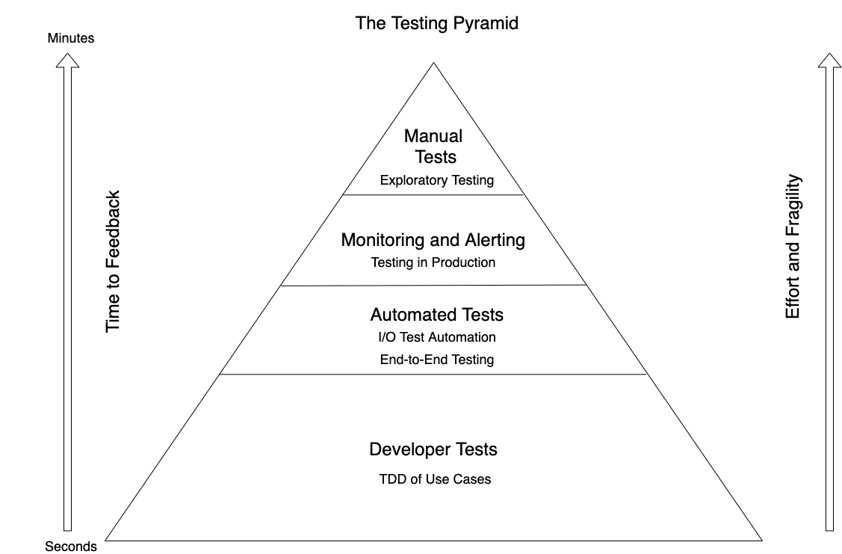
Notes:
An inverted pyramid, too much emphasis on the wrong tests.
Manual Tests
Expensive and give poor feedback. It may take days to run a manual regression pack which gives poor feedback to developers trying to determine what features caused an issue
Automated Gui Tests
Let’s skip for a moment the middle of the test automation pyramid and jump right to the top; the user interface level. Automated user interface testing is placed at the top of the test automation pyramid because we want to do as little of it as possible. We want this because user interface tests often have the following negative attributes:
* Brittle. A small change in the user interface can break many tests. When this is repeated many times over the course of a project, teams simply give up and stop correcting tests every time the user interface changes.
* Expensive to write. A quick capture-and-playback approach to recording user interface tests can work, but tests recorded this way are usually the most brittle. Writing a good user interface test that will remain useful and valid takes time.
Time consuming. Tests run through the user interface often take a long time to run. I’ve seen numerous teams with impressive suites of automated user interface tests that take so long to run they cannot be run every night, much less multiple times per day.
For much of my career test automation meant tests that drove an application through its user-interface. Such tools would often provide the facility to record an interaction with the application and then allow you to play back that interaction, checking that the application returned the same results. Such an approach works well initially. It's easy to record tests, and the tests can be recorded by people with no knowledge of programming.
But this kind of approach quickly runs into trouble, becoming an ice-cream cone. Testing through the UI like this is slow, increasing build times. Often it requires installed licences for the test automation software, which means it can only be done on particular machines. Usually these cannot easily be run in a "headless" mode, monitored by scripts to put in a proper deployment pipeline.
Most importantly such tests are very brittle. An enhancement to the system can easily end up breaking lots of such tests, which then have to be re-recorded. You can reduce this problem by abandoning record-playback tools, but that makes the tests harder to write. [1] Even with good practices on writing them, end-to-end tests are more prone to non-determinism problems, which can undermine trust in them. In short, tests that run end-to-end through the UI are: brittle, expensive to write, and time consuming to run. So the pyramid argues that you should do much more automated testing through unit tests than you should through traditional GUI based testing.
In addition, consider that in the ice-cream cone, the weight of tests is on the adapter – a component that we want to throw away to cope with technological change. If we write automation tests against our WebForms UI what happens when we decide to re-write as a SPA. The simple answer is that we are forced to throw away our tests along with the adapter!

Slide 48
Clean Architecture

Slide 49
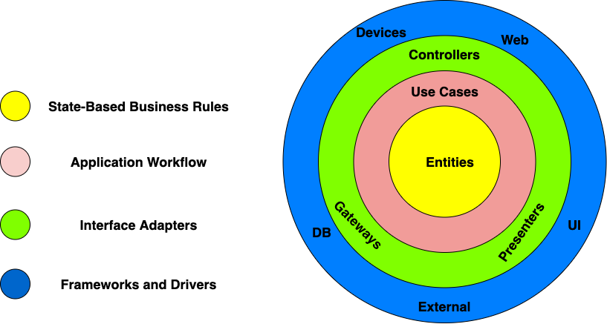

Slide 50
Request Model
Entity
Entity
Interactor
<<interface>>
Entity
Delivery Mechanism
Boundary
Entity
Use Cases
Response Model
Entity Gateway
<<interface>>
Data Structure
Frameworks & Drivers
Interface Adapters
Notes:
The Request Model is a pure data structure, it has no behavior. It comes through the boundary and it reaches the Interactor, that is named not Interactor, but for the use case. The Interactor goes and finds the Entities, calls the appropriate methods, and then gathers the Response Model from the data.
It sounds like HTTP Request-Response, but there is no HTTP.
To Test: Create the Interactor, Create The Request Model, Run the Interactor and check the Response Model.
You have no dependency on the delivery mechanism. In fact the delivery mechanism depends on you, the application controller, which is your plugin into the framework and implements an interface

Slide 51
XUnit is just another adapter
We should TDD against use cases
We may TDD against Entities – Gears!
Notes:
This is the use case it is where we drive code

Slide 52
Request Model
Entity
Entity
Interactor
<<interface>>
Entity
XUnit
Framework
Test
Entity
Use Cases
Response Model
Entity Gateway
<<interface>>
Data Structure
Frameworks & Drivers
Delivery Mechanism
Interface Adapters
In-Memory
DB
Notes:
How do we talk to the Db. We implement the interface with a concrete boundary component that talks to the DB

Slide 53
We don’t TDD against other adapters
XUnit is just another adapter
Notes:
Adapter can change; we are not driving behaviour here, just hooking up

Slide 54
We may write scripted tests to trace end-to-end

Slide 55
Fallacies & Principles

Slide 56
1: Developers write Unit Tests
2: The trigger for a new test is a new function
3: Customers write Acceptance Tests
4: It doesn’t matter if you are test first or test last
5: You want 100% test coverage of your code

Slide 57
1: Developers write Developer Tests
3: The trigger for a new test is a new behavior
2: Customers write Acceptance Criteria
4: Only write production code in response to a test
5: Not all of code should be driven by TDD

Slide 58
End

